Slide 1
Crude Oil VS Auto Industry:
A comparative study on how crude oil prices affect the auto industry.
Sam, Rayan, Erica, & Haley – Project 1

Slide 2
Project Summary
Hypothesis: Stock prices and overall cost of crude oil will have an inverse affect on the Auto Industry. Auto Sales will decrease as oil prices increase and vice versa.
Questions: Do oil prices affect auto sales? Does this affect vary from auto company to auto company? If there is a correlation, is it a simultaneous correlation or is the affect staggered?
Why did we ask these questions?
Summary of findings:
Our hypothesis turned out to be correct and incorrect. Oil prices had an affect on car sales, but revenue increased as prices increased, and decreased as prices decreased. It was a direct correlation instead of an inverse correlation.

Slide 3
Questions and Data
Does the price of oil affect auto industry sales? First, we needed to find data on oil stock prices for the last 5 years. Then we needed to find data on auto sales for the last 5 years. We decided to include the data of the top four U.S. auto companies. We looked for stock prices as well as revenue.
Stock Prices: WTI crude oil stock price using Quandl API. Ford, GM, Toyota stock price using IEX API.
Revenue: Quarterly revenue using IEX API however limited data points for the companies in our sample. Larger revenue sample using CSV files downloaded from Guru.com.

Slide 4
Data Cleanup and Exploration
Started by finding the appropriate API
Include Data into data frame
Verify that we have the same number of data points across our sample of data
Clean and reformat dates
Transform data into numeric data types
Clean and reformat revenue data
Distinguish between annual and quarterly data using loc function
https://github.com/SamLingle/Project--1

Slide 5
Data Analysis
Retrieve appropriate data
Transform stock prices into rates of return
Advantage of using returns series is that it helps in making the time series stationary
Run statistical test (t-test) to confirm the significance of correlation coefficients
https://github.com/SamLingle/Project--1

Slide 6
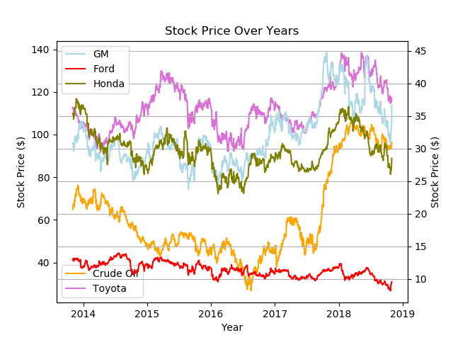

Slide 7
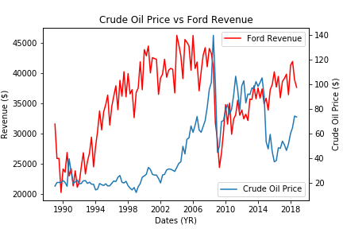

Slide 8
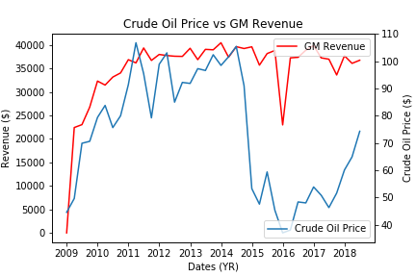

Slide 9
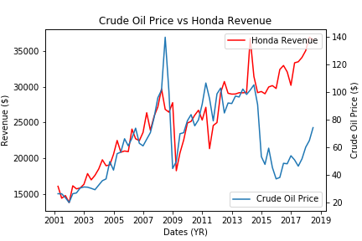

Slide 10
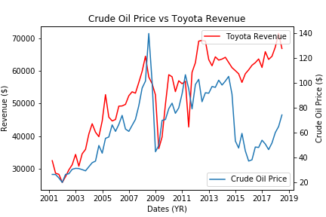

Slide 11
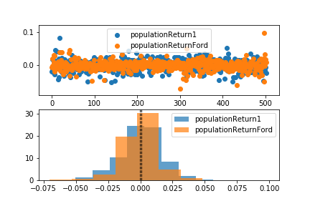
Ford T-Test

Slide 12
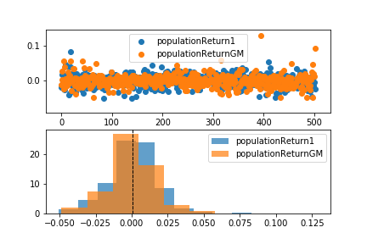
GM T-Test

Slide 13
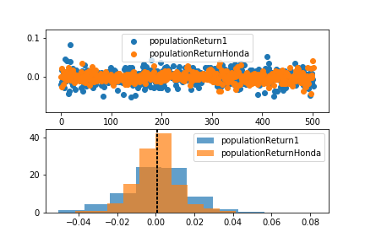
Honda T-Test

Slide 14
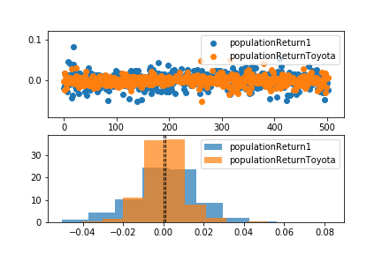
Toyota T-Test

Slide 15
Discussion
Graphs at first glance: When oil prices increased, revenue for car companies increased. When oil prices decreased, car revenue decreased. Same phenomena occurred with stock prices.
T-Test Conclusions:
There is enough evidence in the data to conclude that there is an interaction between the price of crude oil and the American auto industry.
We expected a inverse correlation, but instead there was an direct correlation.
What does this mean?
We’re not sure why this affect occurs. This may be due to a general rise and fall in the stock market. Oil prices may affect our overall economy, and not just car sales, but more tests would be needed to make a better conclusion.

Slide 16
Post-Mortem
Insights while exploring the data:
Uncleaned data
Time series type of transformation
Frequency issues
Price movements issues
Within our revenue data-set we had a mix of annual, daily, and quarterly data. This was creating a noise in time series.
Issues while plotting data, we had to create a second axis
Normalizing data
If we had two more weeks:
We would like to explore the stock market in general. Is it just car sales that oil prices affect, or does oil affect our overall economy? If it’s just car sales, why do car sales increase as oil prices increase?

Slide 17
Questions?

